Slide 1

What Is
Wiring
Baby don't hurt me, no more.

Slide 2

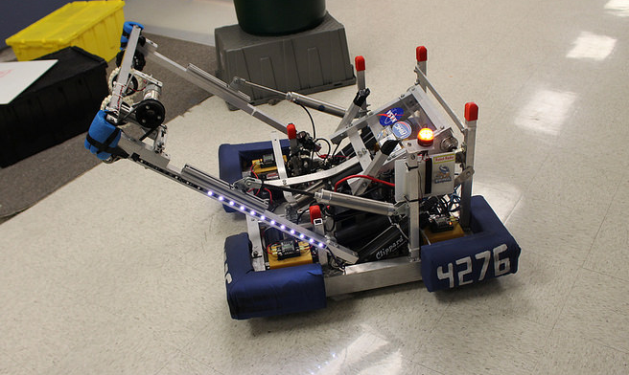

Why Should I Join The Wiring Team?
You get to cut the red wire.
It requires almost no physical activity.
Without you, the robot won’t work.
You get to solder.
EVERYONE ELSE IS NUB
It’s easy to learn.

Slide 3
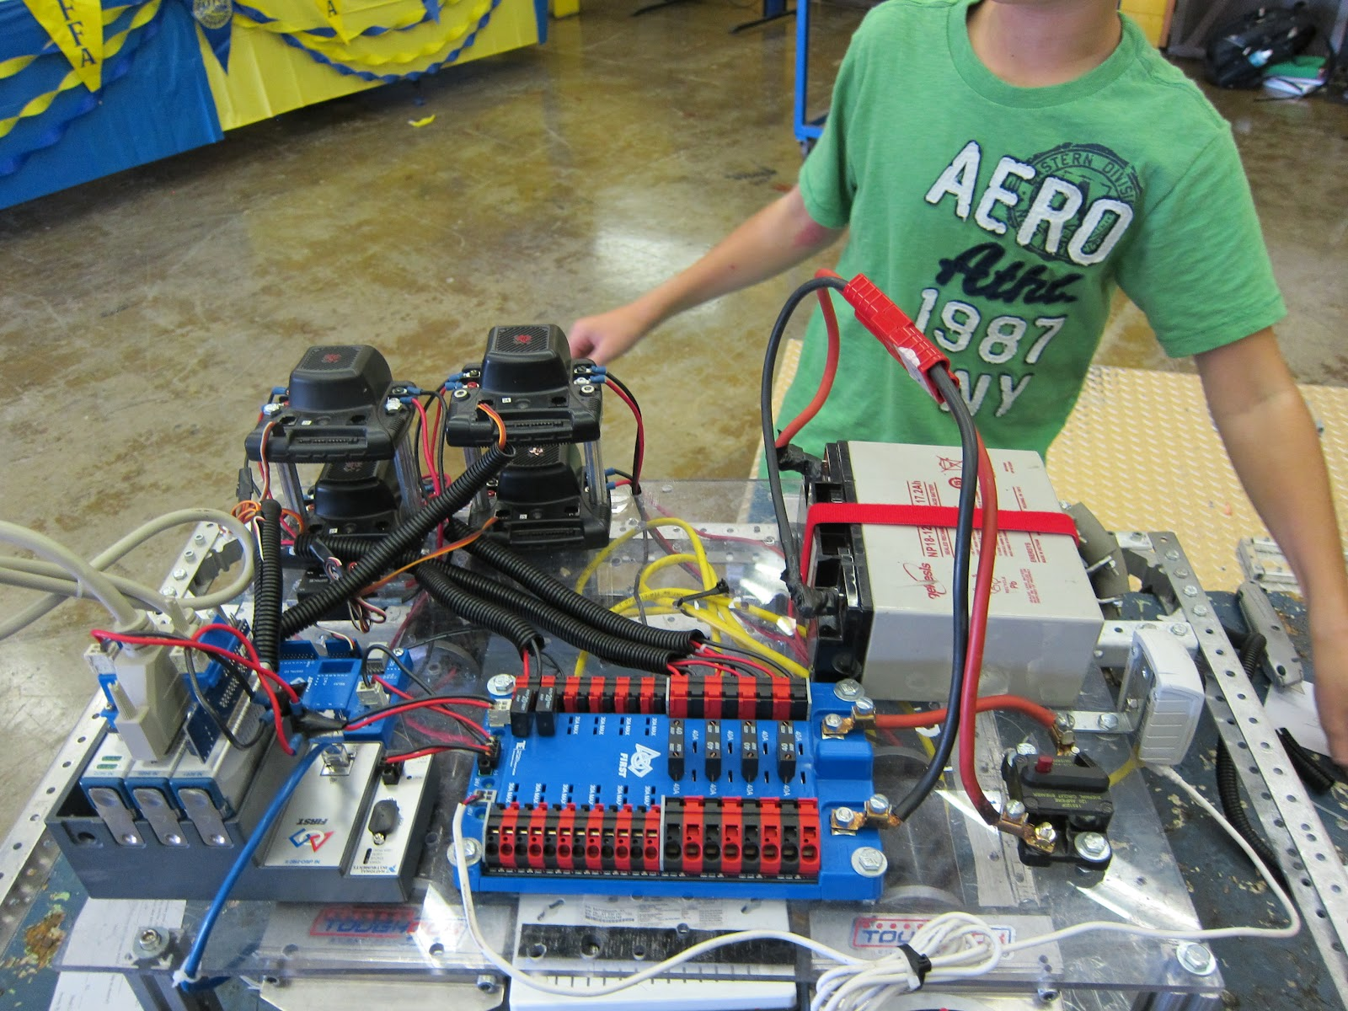
What is wiring?
Connecting, and soldering wires to the different parts of the robot.
Utilizing electronic components and wires to devise a circuit to complete a certain task.

Slide 4
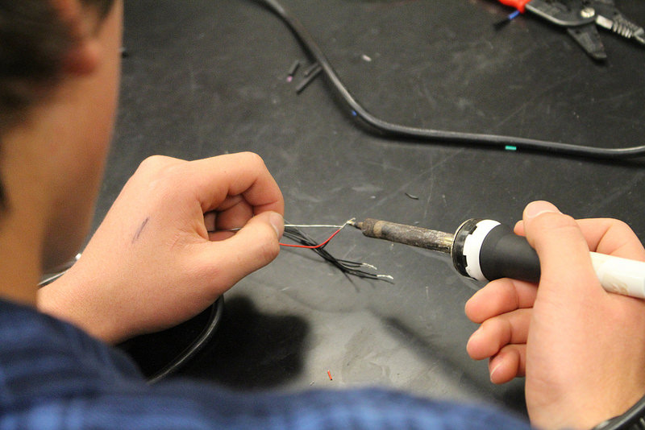
What Will I learn?
During the training sessions you will learn:
How Power Systems Work
Soldering And Crimping
Soldering Mosfets to LED’s (Lab)
Wire Gauges
How To Heat Shrink

Slide 5
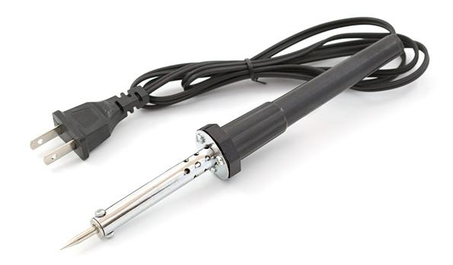
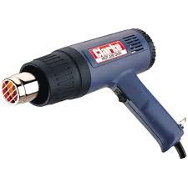
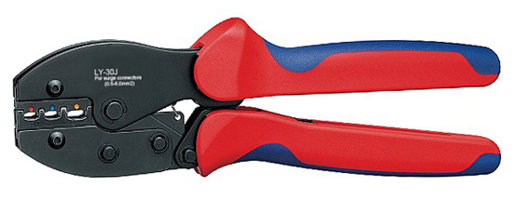
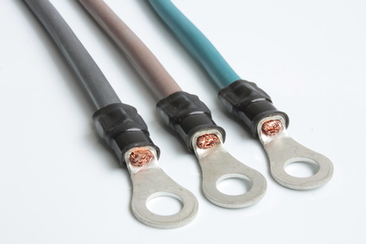
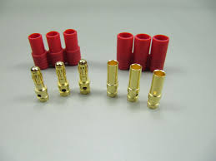
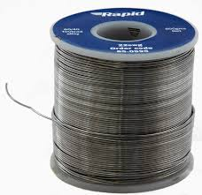
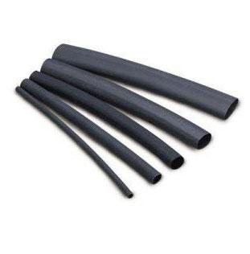
Tools

Slide 6
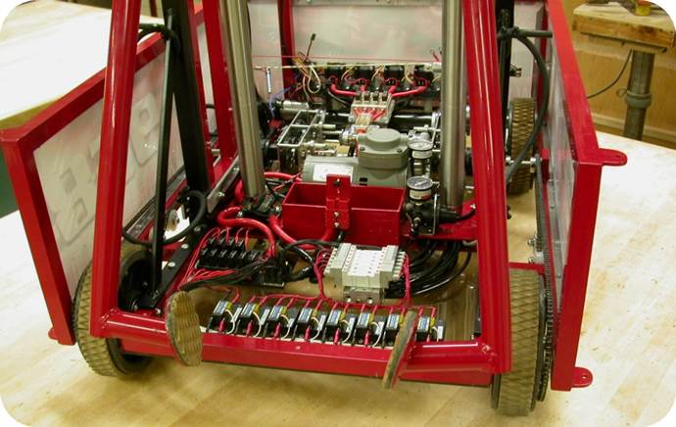
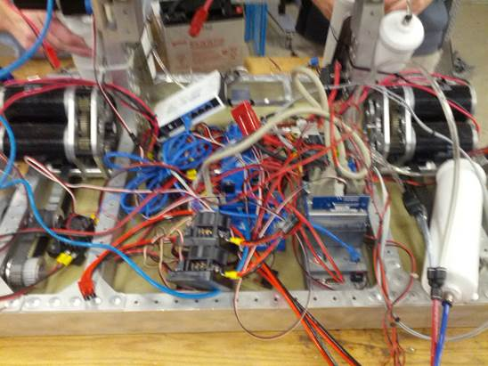
Wiring Do’s And Don’ts
Do: DON’T:

Slide 7
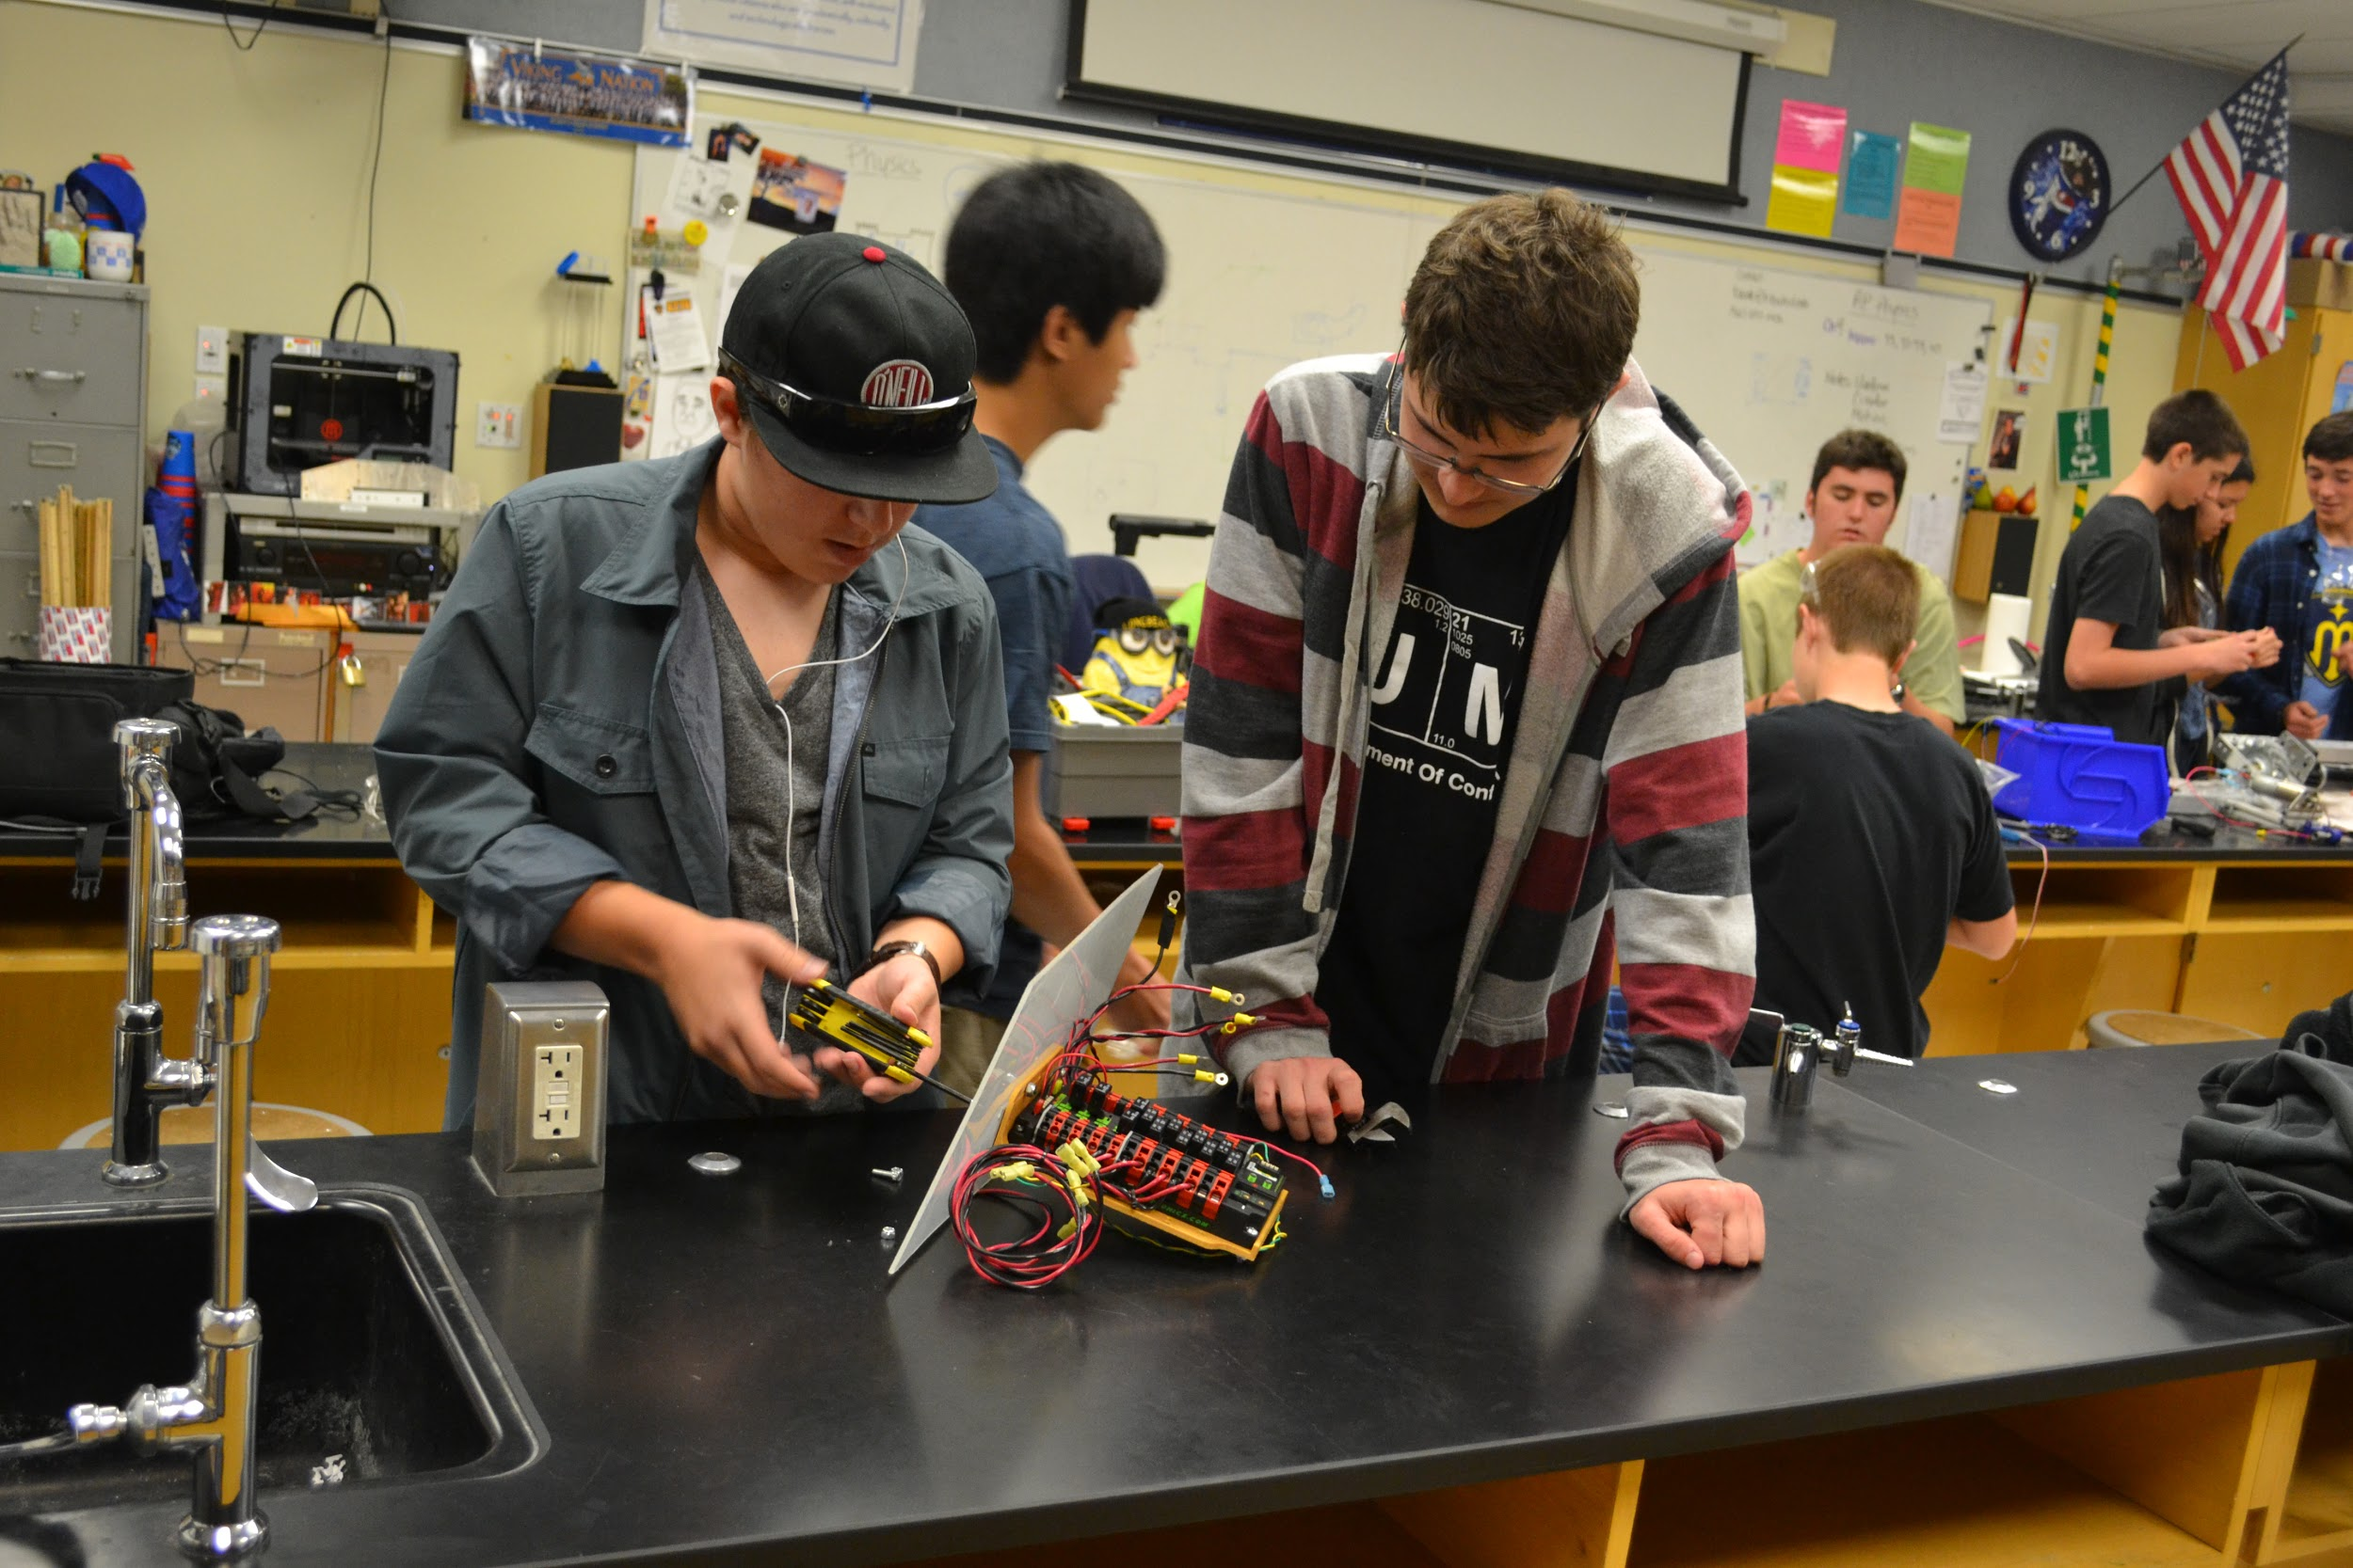
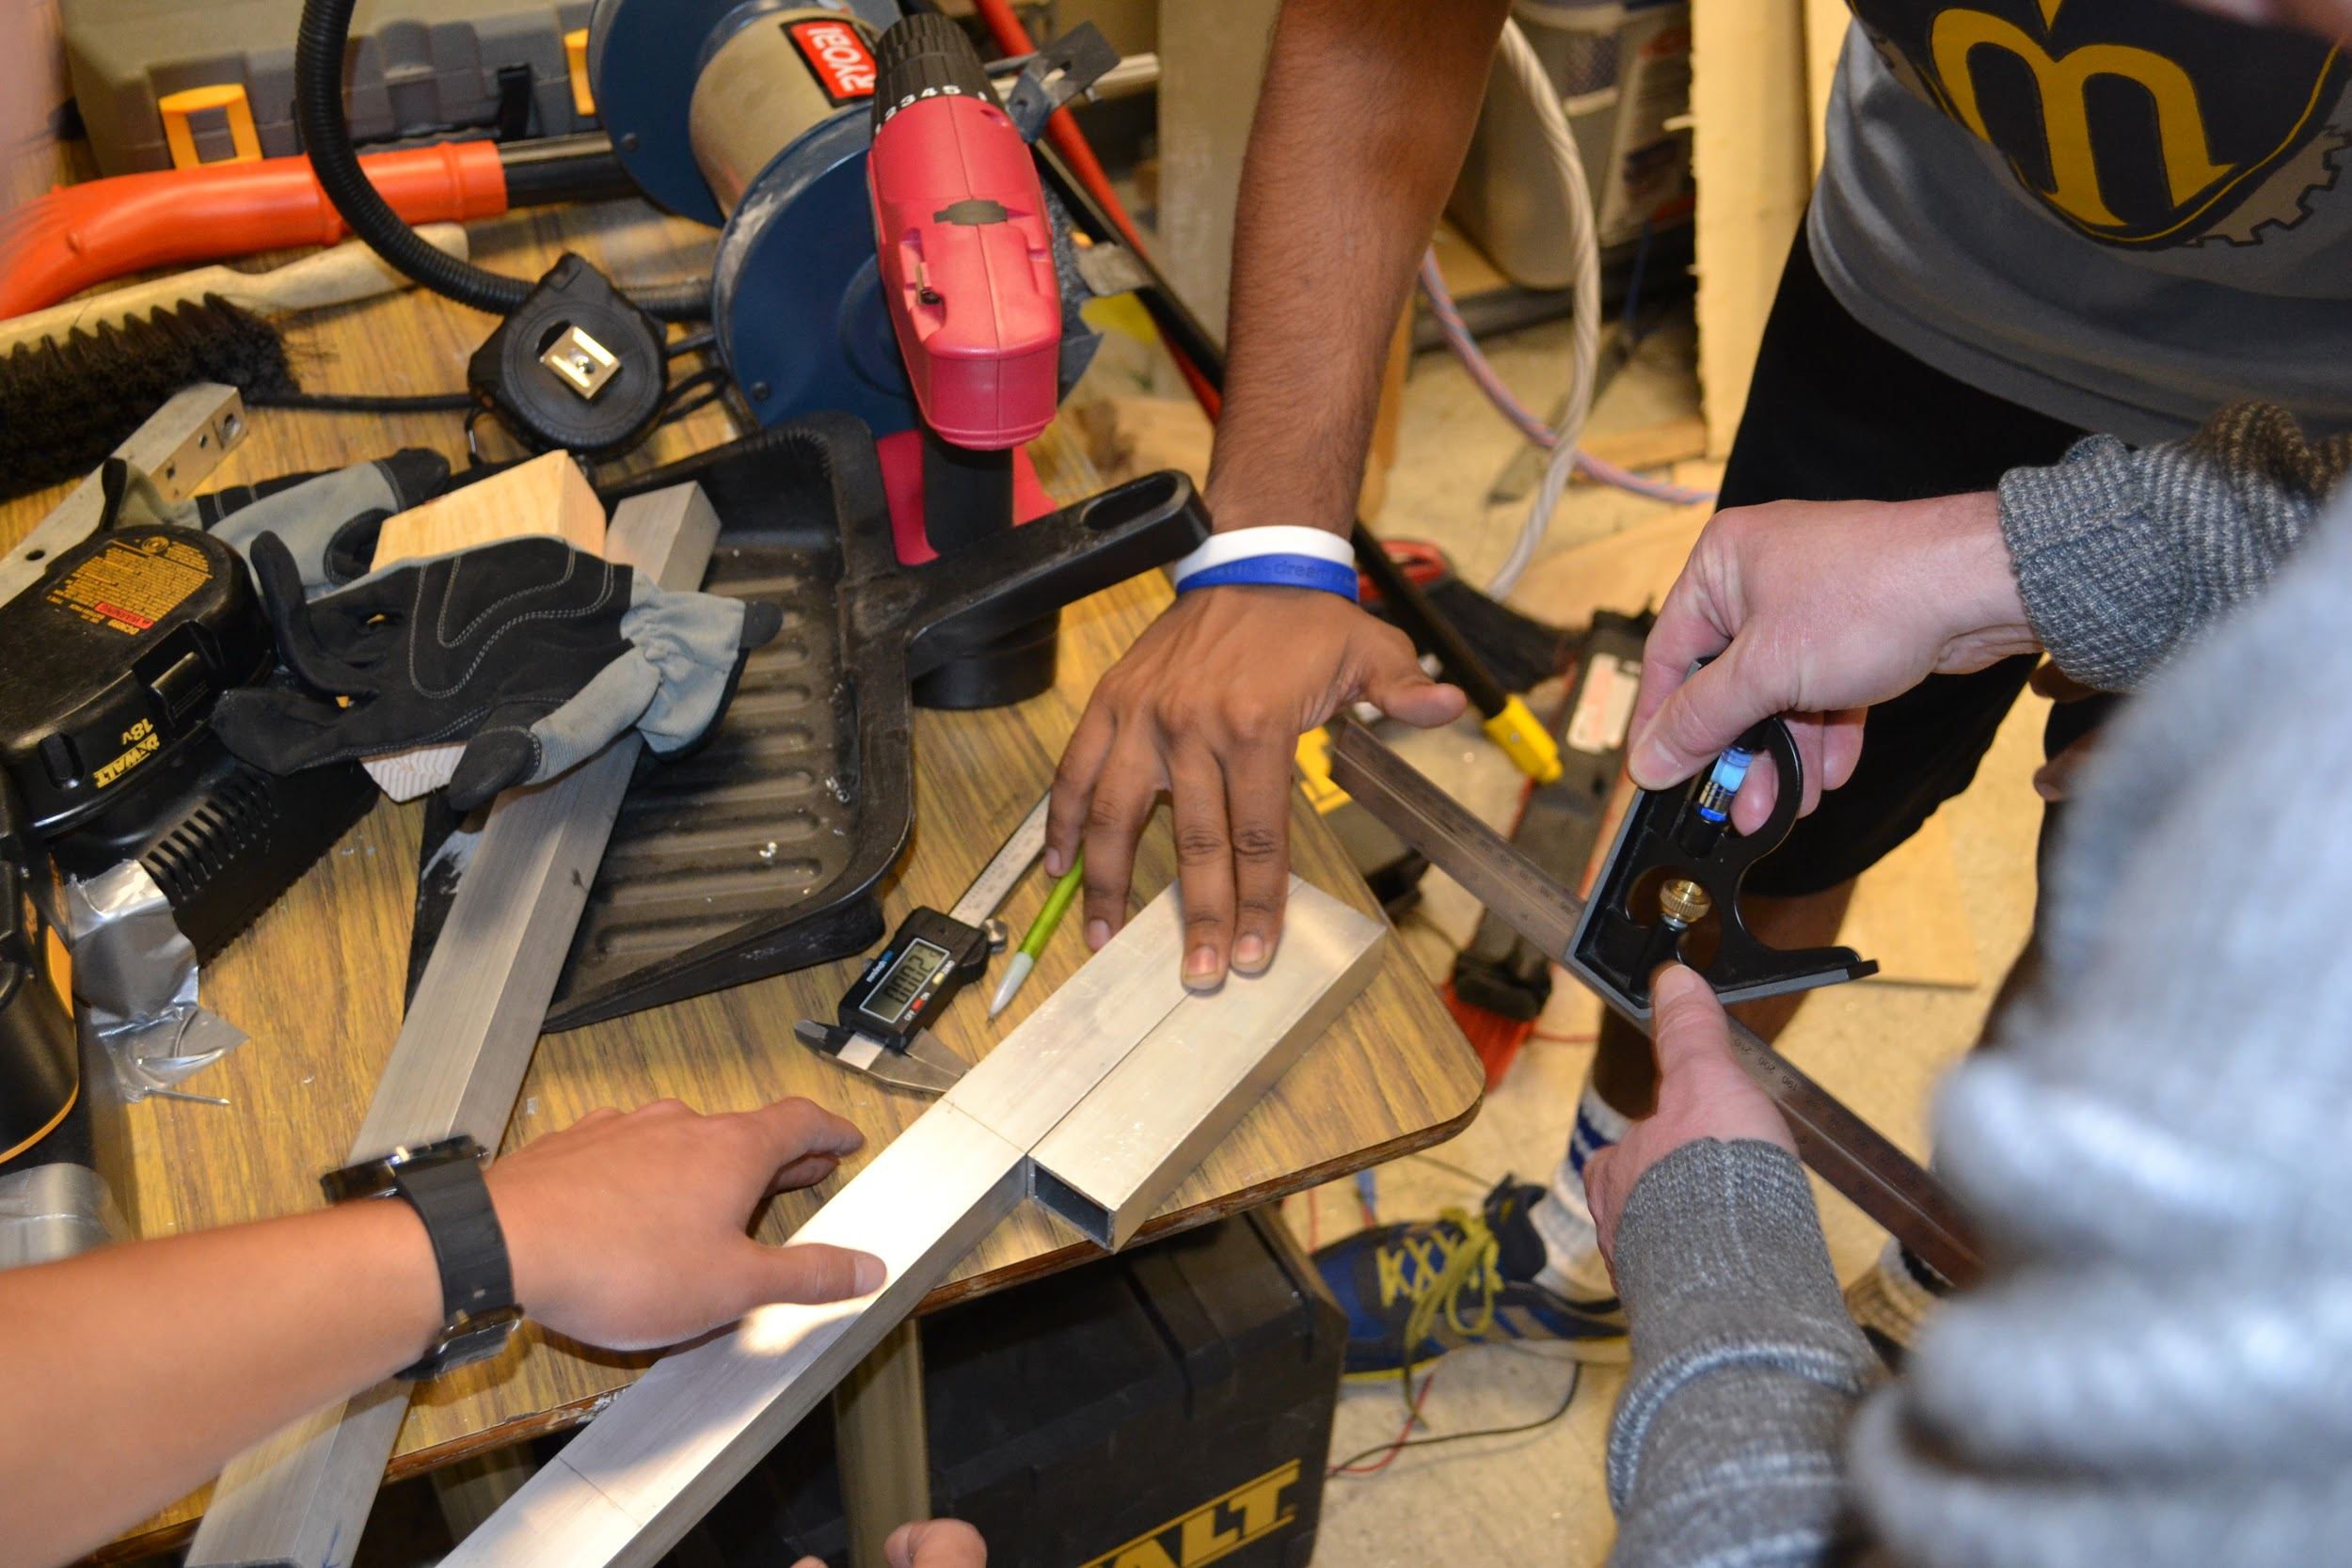
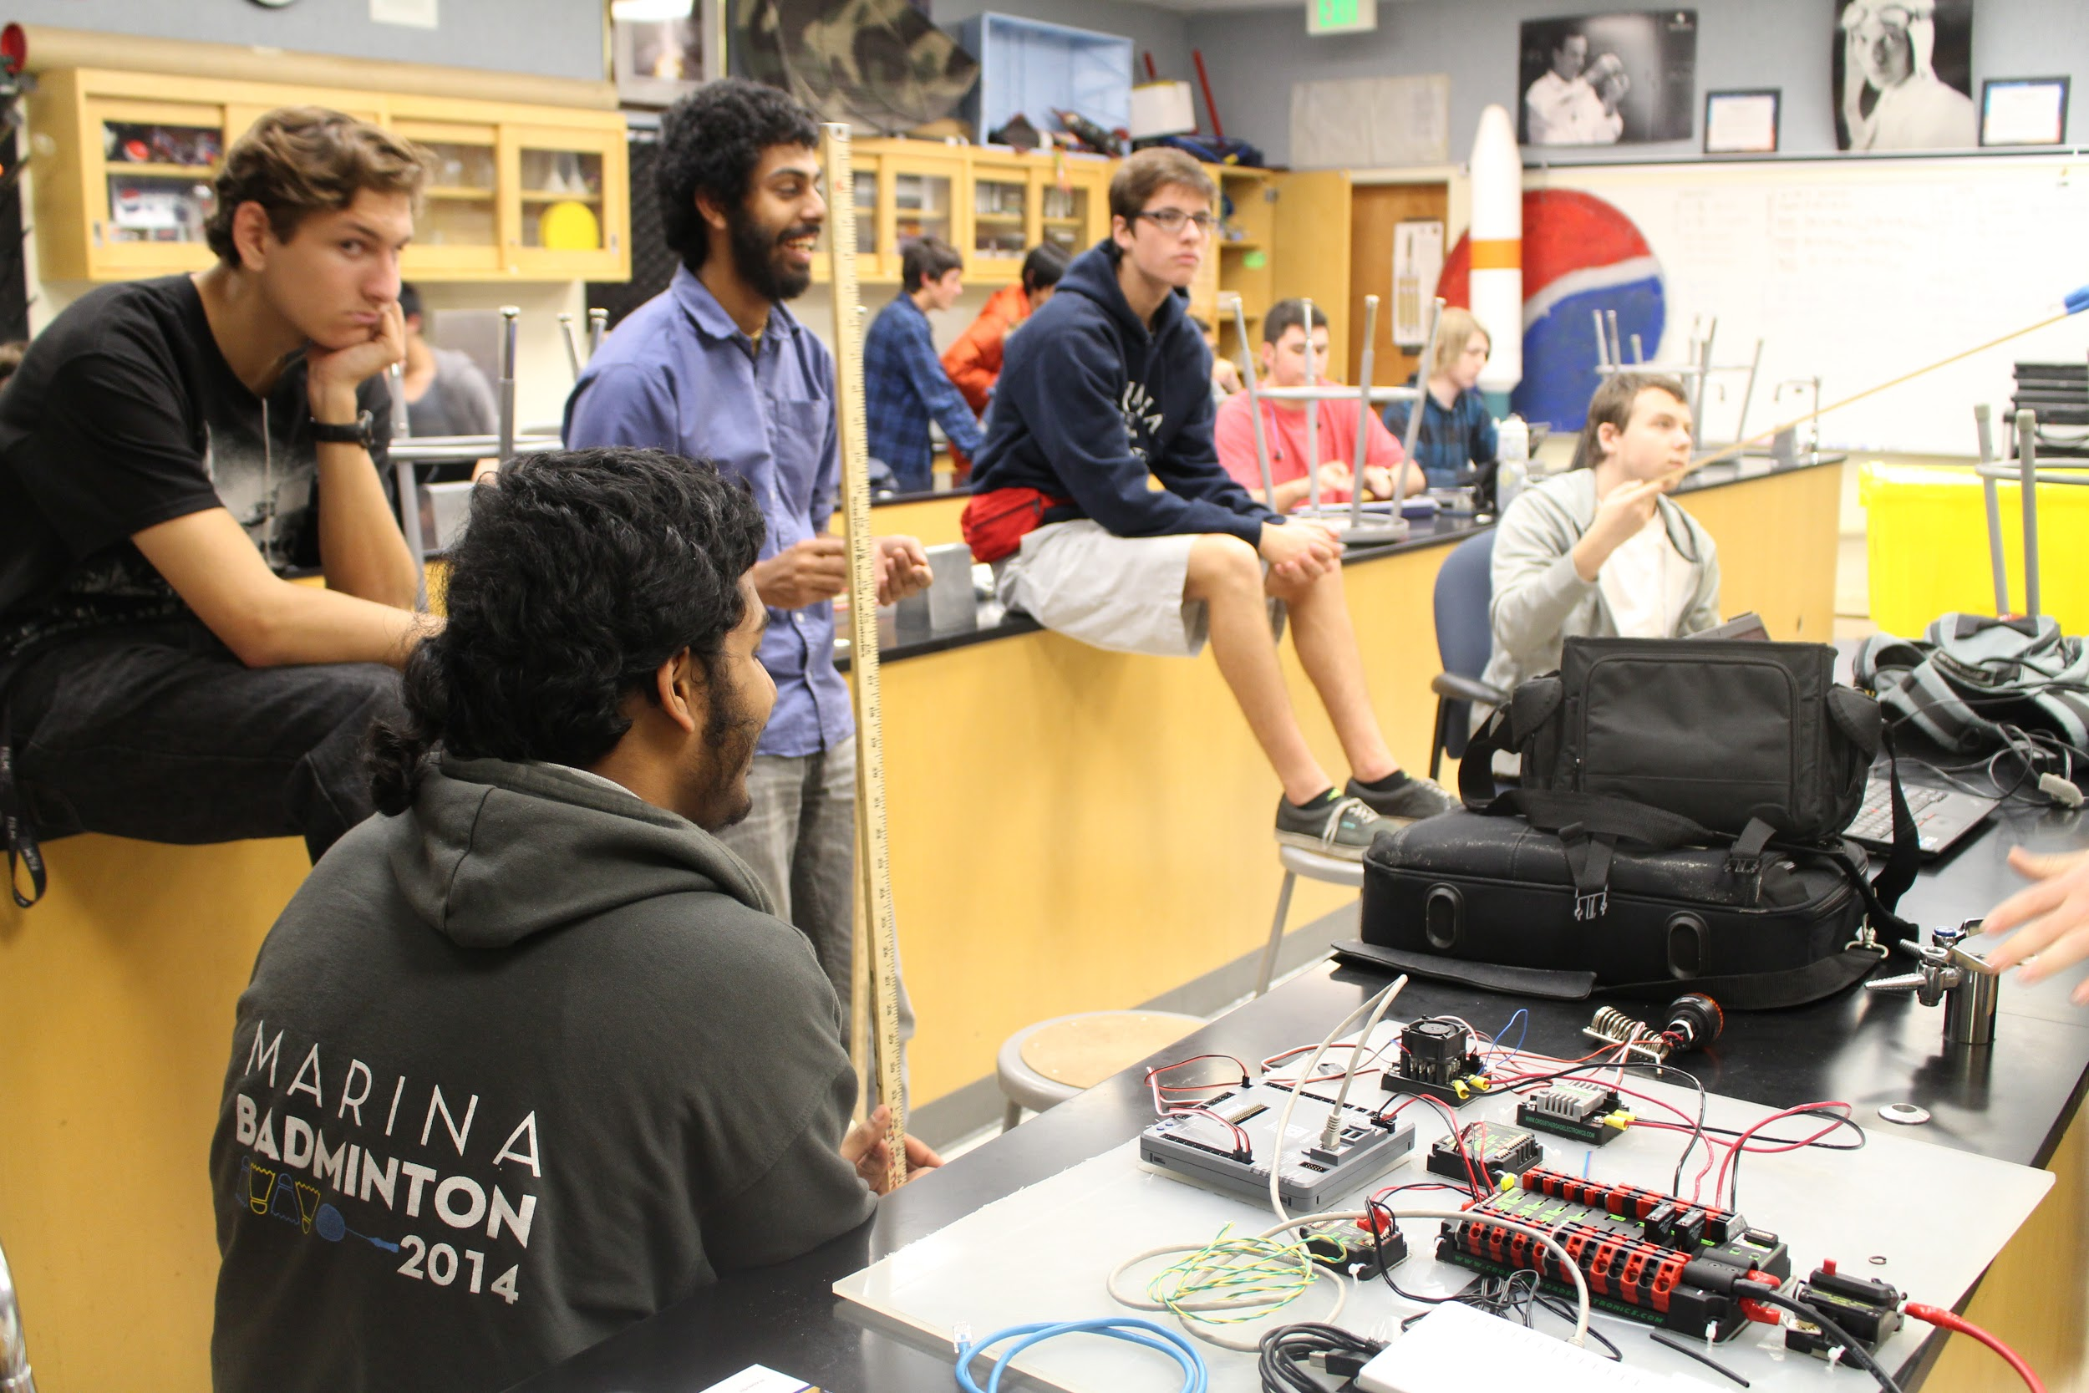
Training Sessions
Week 1: Basic outline of what the course will be about
Basic outline of the wiring course
Week 2: Learning about the power system used on a robot
Students will be learning what the different parts are on the robot.
Basic Soldering and heat shrinking
Week 3: Soldering And Crimping
Students will be creating a circuit with resistors and LED’s
How to crimp, crimp v.s. solder
Week 4: Soldering Mosfets to LED’s
Week 5: Wiring actual robot components.
Proper routing of wires.

Slide 8
ANY QUESTIONS???

